Slide 1



Smart Power Management System
Review n° 1
11-04-2020
INSA Toulouse

Slide 2


TEAM PRESENTATION
TEAM SKILLS :
Team members | Roles
BOURLOT Xavier | Inspector of finished products
CALMO Clarisse | Electronics Engineer / Super Manager
JEAN Thibault | Software and Hardware Engineer
ZHANG Xiaohu | Analog Electronic Engineer
Electronic system conception
Software programming
Prototyping
Routing
Project management
Cooking

Slide 3

SYSTEM OVERVIEW
Smart Power Management System : intelligent system capable of providing energy, either from power network or from solar panel.
Solar Panel Supply Unit : autonomous power block
Communicating Plugs : charges connecting points
.
...
...
Buck part : Energy converter
Our mission : implementing this sub-system.

Slide 4

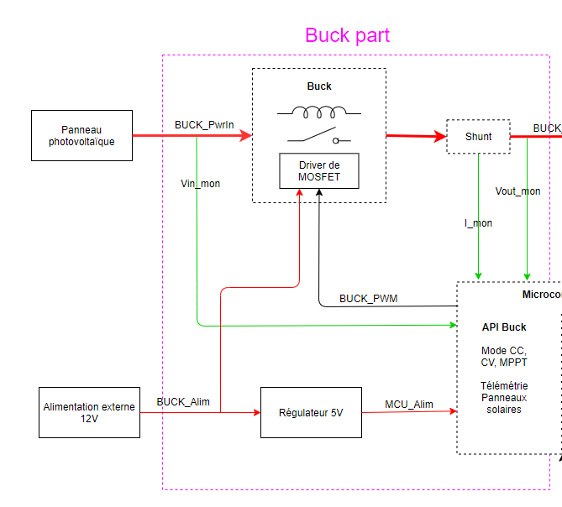
HARDWARE ARCHITECTURE
-Power block located right after the solar panel.
-Energy delivery : up to 200W
-Various control modes :
constant voltage,
constant current,
MPPT,
open loop (test mode)
Towards BMS
Microcontroller

Slide 5

SOFTWARE ARCHITECTURE
Software high level architecture
Function Management_Mode : Management of the different operating modes
Function Get_BuckOutputCurrent
Function Get_BuckOutputVoltage
Function Get_BuckOutputPower
Function Get_BuckInputVoltage
These different functions are there to retrieve the quantities useful for the regulation modes.
Main specifications we are going to implement :
The power supply will be taken first from the photovoltaic panel
Management of the different regulation modes
Prevention against the risks of too much power and too much discharge of the batteries

Slide 6

Next steps
The future step of the project are :
Software development on the project library as well as on the test functions
Finish composant sizing & selection
Continue the schematic developpement and start the PCB layout under Altium
Making further simulations under LTSpice
Writing a report for the final low level architecture

Slide 7

Forecast schedule
This week : finalize the low level architecture
In 2 weeks : send the final schematic & BOM
Next month : write a report with the final software architecture
In 2 months : boards fabrication & write a report with the unit tests

Slide 8



Thank you for your attention
Do you have any question

